Slide 1
PLC Controls Lab
Team 519
Grant Hoffmeyer & Jack Vranicar
Virtual Design Review #2, November 12, 2024

Slide 2
Meet the Team
Grant Hoffmeyer
Grant Hoffmeyer
Systems Engineer
Onyx Oh
Test Engineer
Mason Walters
Design Engineer
Jack Vranicar
Software Engineer

Slide 3
Objective
Grant Hoffmeyer
The objective of this project is to develop curriculum for Mechanical Engineering students at the FAMU-FSU College of Engineering to address the current lack of Programmable Logic Controller (PLC) training.
Notes:
https://meetings.informs.org/wordpress/phoenix2023/exhibit-hall/famu-fsu-college-of-engineering-industrial-manufacturing/

Slide 4
MCU Vs. PLC
Grant Hoffmeyer
Smaller
Limited power
Small scale
C
Durable
Higher power
Large scale
Ladder logic

Slide 5
Key Goals
Grant Hoffmeyer
Create and produce 3 PLC labs
Provide student performance milestones
Emphasize importance of PLCs in industry

Slide 6
Targets
Jack Vranicar
PLC Learning System
Control
Facilitate
Plant
Notes:
To determine the targets for this project, we organized our thoughts into each of the highest-level functions.

Slide 7
Critical Functions
Jack Vranicar
Plant
Disconnect Power
Transfer Critical Knowledge
Integrate Logic
Deliver Output Signal
Receive Input Signal
Facilitate
Notes:
To determine the targets for this project we organized our thoughts into each of the highest-level functions.

Slide 8
Critical Functions & Targets
Jack Vranicar
Plant
Disconnect Power
Transfer Critical Knowledge
Integrate Logic
Deliver Output Signal
Receive Input Signal
Facilitate
2 Second Disconnect Time
10 MB CPU
25 ms
25 ms
20 FAQ

Slide 9
Concept Generation
Jack Vranicar
Morphological Chart
Brainstorming

Slide 10
Concept Selection
Jack Vranicar
BPWC
HoQ
Pugh
AHP

Slide 11
Motor Drivers – H Bridges
Jack Vranicar
+ V
+ V
GND
GND

Slide 12
Motor Drivers – H Bridges
Jack Vranicar
+ V
+ V
GND
GND

Slide 13
Motor Drivers – H Bridges
Jack Vranicar
+ V
+ V
In 1
GND
In 2
In 1
GND
In 2
* Diodes not included for simplicity

Slide 14
Motor Drivers – PWM
Jack Vranicar
+ 100%
+ 50%
In 1
GND
In 2
In 1
GND
In 2
Notes:
http://playwithrobots.com/dc-motor-driver-circuits/

Slide 15
Motor Drivers Concepts
Jack Vranicar
PLCs
Arduinos
PWM
Digital IO
Transistors
Diodes
Ladder Logic
C

Slide 16
Concepts 2 & 3
Jack Vranicar
Notes:
Already have a conveyor belt and PLC. The PLC is so old they refuse to give us a license for it

Slide 17
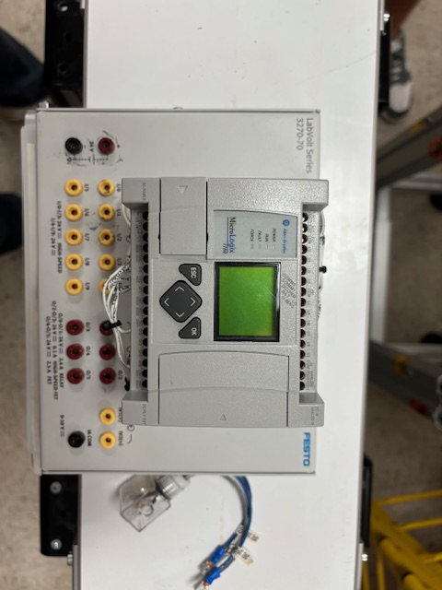
Hardware
Grant Hoffmeyer

Slide 18
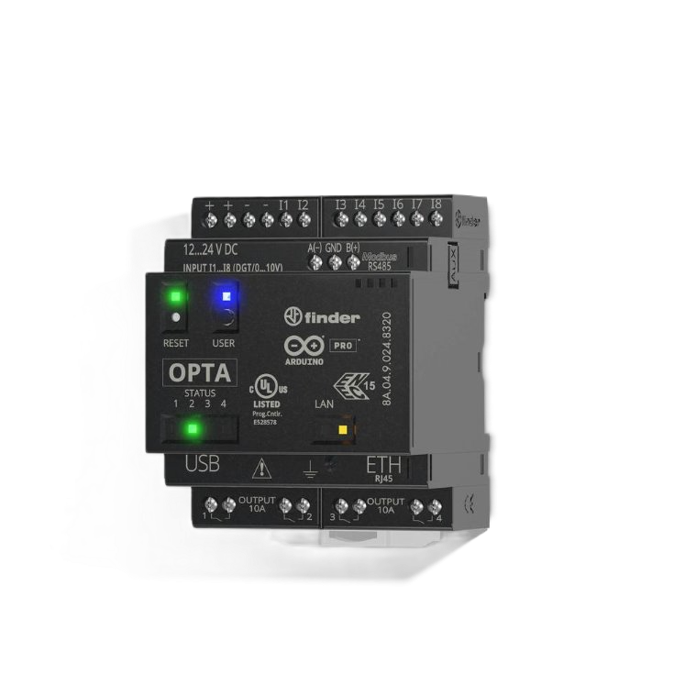
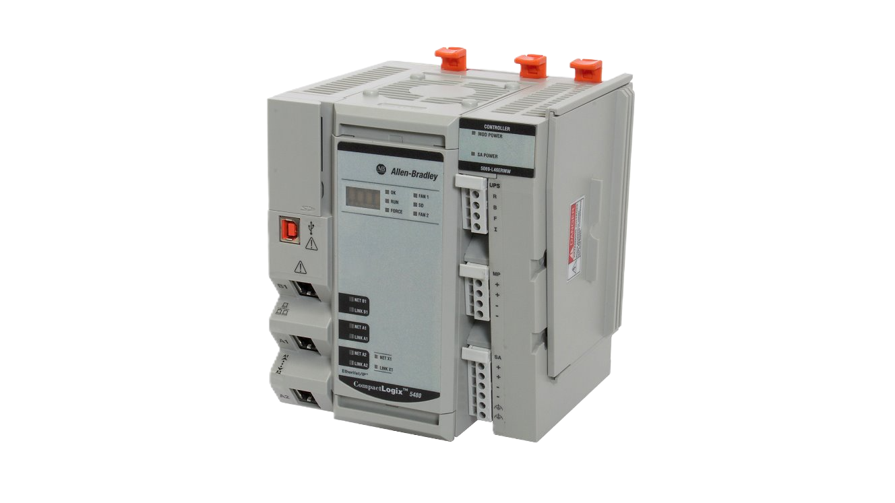
Bill of Materials
Grant Hoffmeyer
PLC?
OR
Amazon.com : arduino plc
allen-bradley.industrialautomationco.com/allen-bradley/?part_number=5069-L306ER-A&pnparameter=5069-L306ER-A&cq_src=google_ads&cq_cmp=359119035&cq_con=1342504952089723&cq_term=5069-L306ER-A&cq_med=&cq_plac=&cq_net=o&cq_pos=&cq_plt=gp&msclkid=ce105df790d917ba4d823ac592b794b7&utm_source=bing&utm_medium=cpc&utm_campaign=Allen-Bradley&utm_term=5069-L306ER-A&utm_content=5069-L306ER-A

Slide 19
Arduino Opta
Grant Hoffmeyer
Pros
$120 - $250
Software
Cons
Reliability
Limited I/O
Ladder logic
Uncommon
Small
Technical support

Slide 20
CompactLogix
Grant Hoffmeyer
Pros
Industry standard
Rockwell support
Cons
$1,500 – $2,300
Software license
Ladder logic
Size
Reliable
1 lab station

Slide 21
Future Work
Grant Hoffmeyer
BoM
VDR3
Hardware
Software
Arduino
Allen-Bradley
Rockwell support
Mock-up
Problem areas
Current state
PLC
Motors
LinkedIn Learning
Studio 5000

Slide 22
Questions?
Grant Hoffmeyer
+ V
In 1
GND
In 2

Slide 23
References
PLCs vs. Microcontrollers: What Is the Difference? – PLC Direct (plc-direct.com)
https://search.arduino.cc/search/?q=PLC**
https://rockwellautomation.custhelp.com/app/answers/answer_view/a_id/37951/~/what-software-is-needed-to-support-the-micrologix-1100%3F#:~:text=RSLogix%20Micro%20Starter%20Lite%20is%20available,for%20free%20download%20to%20program%20the%20ML1100.
https://www.smcelectric.com/products/rockwell-automation-ab1769l16erbb1b/#:~:text=Rockwell%20Automation%20CompactLogix%205370%20L1%20Controller%2C%20Dual%20Ethernet,POINT%20I%2FO%2C%204%20Ethernet%20IP%20Nodes%20%242%2C240.41%20%28EA%29

Slide 24
Ladder Logic Example
Jack Vranicar

Slide 25
PLC Controls Lab
Team 519
Grant Hoffmeyer & Jack Vranicar
Virtual Design Review #2, November 12, 2024

Slide 26
Meet the Team
Onyx Oh
Grant Hoffmeyer
Systems Engineer
Onyx Oh
Test Engineer
Mason Walters
Design Engineer
Jack Vranicar
Software Engineer

Slide 27
Sponsor and Advisor
Onyx Oh
Industry Collaborator
Rockwell Automation
Sponsor
Dr. Camilo Ordoñez
Academic Advisor
Dr. Shayne McConomy

Slide 28
Objective
Onyx Oh
The objective of this project is to develop curriculum for Mechanical Engineering students at the FAMU-FSU College of Engineering to address the current lack of Programmable Logic Controller (PLC) training.
https://meetings.informs.org/wordpress/phoenix2023/exhibit-hall/famu-fsu-college-of-engineering-industrial-manufacturing/

Slide 29
What is a PLC?
Onyx Oh
Programmable Logic Controllers (PLCs) are computers that are widely used to control industrial equipment. They facilitate manufacturing and production lines by analyzing inputs and controlling outputs.
https://www.solutiontree.com/blog/enhancing-plc-process/

Slide 30
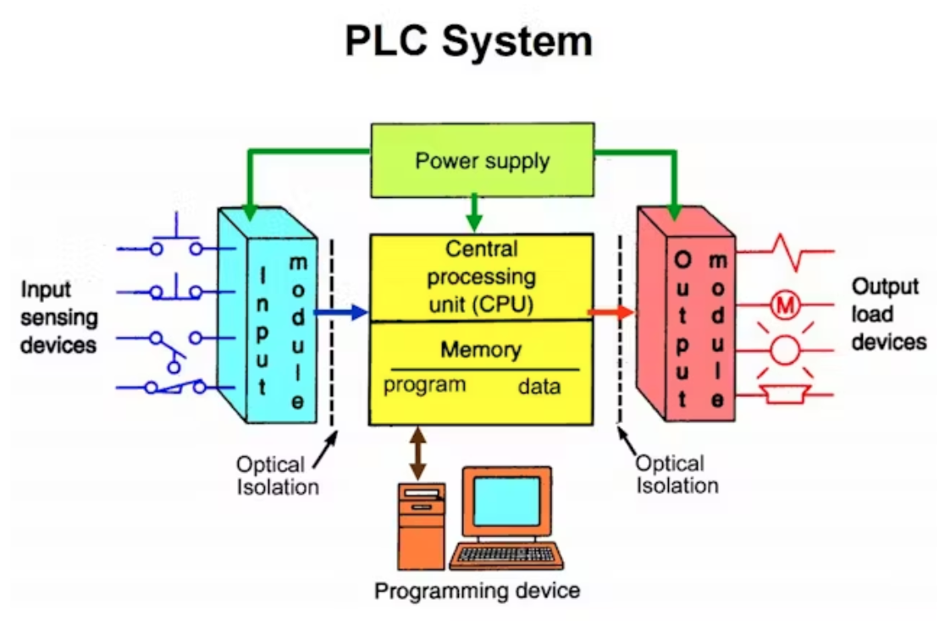
Why PLCs?
Onyx Oh
Reduce costs
Saves time
Minimal manual labor
~$11.6 billion market value
https://www.amazon.com/EJWFASCV-BMEH586040-Redundant-Industrial-Environments/dp/B0D982QLGM
Notes:
PLCs reduce costs, saves time, and yields little to no manual labor. The current market value of PLCs is roughly $11.6 billion and is expected to continue to grow by 4.7% in the next eight years

Slide 31
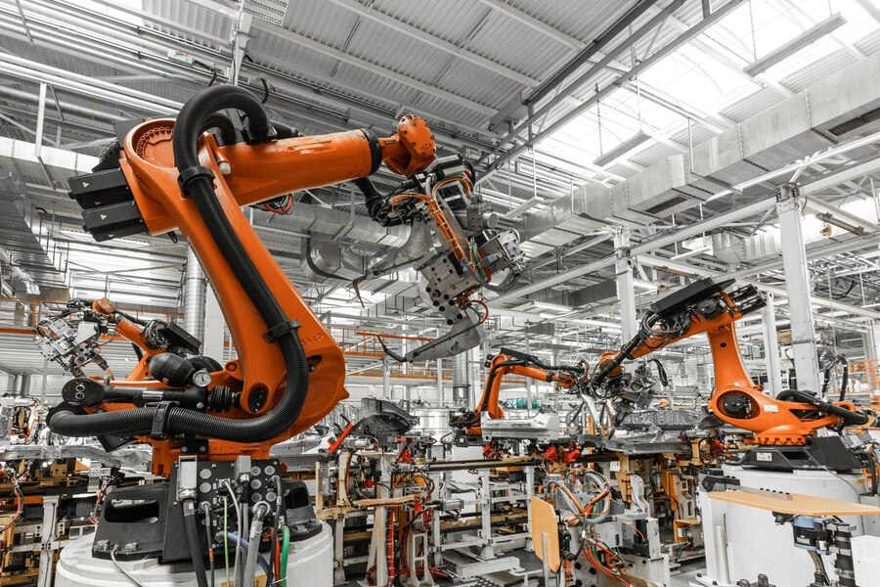
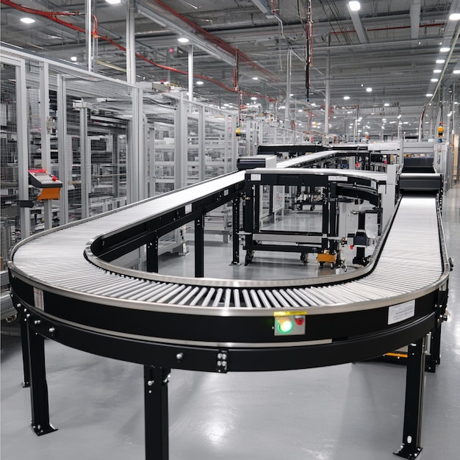
Applications of PLCs
Onyx Oh
https://www.freepik.com/free-photo/photo-automobile-production-line-welding-car-body-modern-car-assembly-plant-auto-industry_26150191.htm#fromView=search&page=1&position=6&uuid=fd68e528-1825-48bf-a991-c38e381b081b
https://www.freepik.com/premium-ai-image/automated-conveyor-systems-moving-products-different-stages-production-process_298771504.htm#fromView=search&page=1&position=13&uuid=122b5ab9-a6d8-4dd6-9324-f5d8c1f74f42

Slide 32
Key Goals
Onyx Oh

Slide 33
Key Goals
Onyx Oh
Design and produce three labs that introduce the fundamentals of PLCs, programming methods, and troubleshooting techniques
Create curriculum that emphasizes the importance and opportunities associated with PLCs, as they are widely used in many different industries
Ensure students can apply logic principles to various PLC models and applications
Create performance milestones through implementing post lab-assessments and surveys

Slide 34
Assumptions
Onyx Oh
Access to shop facilities, tools, materials, university
personnel, & communication
PLC equipment and hardware will be provided by the university
Students will have a basic understanding of Mechatronics concepts from the course and pre-requisites
The professor and teaching assistants will be competent to supervise labs and teach the material

Slide 35
Assumptions
Onyx Oh
Labs will take place in the Mechatronics Lab at the College of Engineering (Room B356)
Legal and safety protocols will be implemented in the lab
The classroom will obtain electrical safety equipment prior to labs utilizing PLCs
Liquids or food will be prohibited in the lab

Slide 36
Primary Markets
Mason Walters
Dr. Camillo Ordonez,
Mechatronics 1 Professor
Mechatronics 1 Students

Slide 37
Secondary Markets
Mason Walters
Outside Universities
PLC Manufacturers

Slide 38
Stakeholders
Mason Walters
 | Investors | Decision Makers | Advisors | Receivers
Sponsors | Dr. McConomy Dr. Ordonez | Dr. Ordonez | Dr. McConomy Dr. Ordonez | Dr. McConomy Dr. Ordonez
Managers | Dr. McConomy Dr. Ordonez | Dr. McConomy Dr. Ordonez | Dr. McConomy Dr. Ordonez | Dr. McConomy Dr. Ordonez
Experts | Rockwell Auto. | Rockwell Auto. | Dr. McConomy Dr. Ordonez | Rockwell Auto.
Operators | N/A | Dr. Ordonez | Dr. Ordonez Rockwell Auto. | Dr. Ordonez Students, TA's Rockwell Auto.
General Readers | N/A | Dr. Ordonez | Dr. McConomy Dr. Ordonez | Dr. McConomy Dr. Ordonez Students, TA's General Public

Slide 39
Stakeholders
Mason Walters
 | Investors | Decision Makers | Advisors | Receivers
Sponsors | Dr. McConomy Dr. Ordonez | Dr. Ordonez | Dr. McConomy Dr. Ordonez | Dr. McConomy Dr. Ordonez
Managers | Dr. McConomy Dr. Ordonez | Dr. McConomy Dr. Ordonez | Dr. McConomy Dr. Ordonez | Dr. McConomy Dr. Ordonez
Experts | Rockwell Auto. | Rockwell Auto. | Dr. McConomy Dr. Ordonez | Rockwell Auto.
Operators | N/A | Dr. Ordonez | Dr. Ordonez Rockwell Auto. | Dr. Ordonez Students, TA's Rockwell Auto.
General Readers | N/A | Dr. Ordonez | Dr. McConomy Dr. Ordonez | Dr. McConomy Dr. Ordonez Students, TA's General Public

Slide 40
Customer Needs
Mason Walters
Customer Need #1
The curriculum should prepare students to broaden their skill sets for future employment opportunities
Customer Need #3
Focus on software and hardware troubleshooting with a focus in ladder logic
Customer Need #2
The curriculum should match the content covered at other universities and preliminary training
Beneficial concepts added to the labs would include the creation of communication networks, human machine interfaces (HMIs), and structured text
Customer Need #4
Notes:
Customer need #1: Content should provide students with introductory understanding (Q1), prior experience simulating an automated system will allow students to succeed as a new employee (Q8)
Customer need #2: Content matches the quality that is produced at other universities (Q2), content should match concepts covered in Rockwell’s training toolkit to reduce the learning curve for new employees (Q4), curriculum will support Rockwell’s training material (Q10)
Customer need #3: ladder logic is crucial for Rockwell’s training (Q3), students will be best prepared with conditions that match the industry, which includes software and hardware troubleshooting (Q6)
Customer need #4: communication networks is an advanced skill (Q7), HMI development is an advanced skill (Q9)

Slide 41
Functional Decomposition
Mason Walters
PLC Learning System
Control
Facilitate
Plant

Slide 42
Functional Decomposition
Mason Walters
Control
Integrate logic
Interpret visual feedback

Slide 43
Functional Decomposition
Mason Walters
Plant
Control inputs and outputs
Move motors
Supply power
Receive input signal
Deliver output signal
Manage data
Record data
Communicate Data
Limit maximum voltage
Limit maximum current
Disconnect power

Slide 44
Functional Decomposition
Mason Walters
Facilitate
Guide students
Guide faculty
Transfer instructions
Provide safety protocols
Transfer critical knowledge
Provide performance measures

Slide 45
Looking Forward
Mason Walters
Receive material/training from Rockwell
Coordinate with Center of the Advancement of Teaching
Familiarize ourselves with FSU and Rockwell licensing and vending processes
Continue learning and programming PLCs using Ladder Logic

Slide 46
Hardware

Slide 47
Back Up Slides

Slide 48
Slide Headline
Try to keep text at 16 pt minimum.
Try to put as few words as possible on the slide if you’re using for a presentation.
Mix and match the backgrounds as shown in this template or just use one throughout.
You can put department/unit logos in slide master at Horizontal 0.89” Vertical 6.44” From top left corner

Slide 49
Font Check
This is 10-point
This is 15–point Times
This is 20–point
This is 25–point
This is 30–point
This is 35–point
This is 40–point
This is 50–point
This is 60–point
This is 72–point
Notes:
Use at least 20-point font in Room A105, B134, and B136
Use at least 25-point font in Room B135

Slide 50
College of Engineering Color Palette
1 2 3 4
Pantone: PMS 195 C
RGB: 120, 47, 64
Hex: #782F40
CMYK:19, 90, 50, 55
1 2 3 4
Pantone: Black C
RGB: 0, 0, 0
Hex: #000000
CMYK:0, 0, 0, 100
Garnet
Black
1 2 3 4
RGB: 238, 118, 36
Hex: #EE7624
CMYK:2, 66, 99, 0
1 2 3 4
Pantone: PMS 000C
RGB: 255, 255, 255
Hex: #FFFFFF
CMYK: 0, 0, 0, 0
Fang
Orange
White
Notes:
Avoid 75% Black in B135

Slide 51
Accent Color Palette
1 2 3 4
RGB: 0, 59, 111
Hex: #003B6F
CMYK:
1 2 3 4
RGB: 0, 59, 111
Hex: #003B6F
CMYK:
1 2 3 4
RGB: 251, 236, 93
Hex: #FBEC5D
CMYK:
1 2 3 4
RGB: 219, 215, 210
Hex: #DBD7D2
CMYK:
1 2 3 4
RGB: 251, 236, 93
Hex: #FBEC5D
CMYK:
1 2 3 4
RGB: 219, 215, 210
Hex: #DBD7D2
CMYK:
Tardis Blue
Tardis Blue
Corn
Timberwolf
Corn
Timberwolf
1 2 3 4
RGB: 206, 0, 88
Hex: #CE0058
CMYK: 0, 100, 43, 12
1 2 3 4
RGB: 206, 0, 88
Hex: #CE0058
CMYK: 0, 100, 43, 12
1 2 3 4
RGB: 104, 40, 96
Hex: #682860
CMYK:
1 2 3 4
RGB: 220, 220, 220
Hex: #DCDCDC
CMYK:
Rubine Red
Rubine Red
Imperial
Gainsboro
1 2 3 4
RGB: 72, 146, 155
Hex: #48929b
CMYK:
1 2 3 4
RGB: 64, 224, 208
Hex: #40E0D0
CMYK:
1 2 3 4
RGB: 255, 139, 0
Hex: #FF8B00
CMYK:
Asagi-iro
Turquoise
American Orange
Notes:
Remove American orange add hyperlink grey
Make corn the last for b135
All work in 134 imperial move later
Tardis doesn’t work in b136

Slide 52
F7AB19
D67F15
EE7624
D64615
F73119
Analogous
6E3610
F0A16C
EE7624
6E4931
BASB1C
Monochromatic
A14508
4BED3B
EE7624
250CED
2010A1
Triad
A1470C
FF8C40
EE7624
0098A1
24E2ED
Complementary
28A164
2FED8D
EE7624
0848A1
1871ED
Split Complementary
EDAC2F
3BED93
EE7624
0C6AED
ED2F18
Double Split Complementary
ED660C
C7ED3B
EE7624
0CE1ED
A418ED
Square
BA7E09
87724A
EE7624
60EFCF
09BA61
Compound
https://color.adobe.com/create/color-wheel
AD551A
6E3610
EE7624
FA7625
D46820
Shades
Notes:
These are the variants that work well with Fang Orange. The bolded items show well on the projectors.

Slide 53
85412D
8F3831
782f40
8F3176
792D85
Analogous
C44D69
8E626D
782F40
C48796
451B25
Monochromatic
C43959
78743B
782F40
236178
43A2C4
Triad
C43959
C46078
782F40
25C43D
2F783A
Complementary
93C460
577835
782F40
39C49D
297861
Split Complementary
784435
5A783B
782F40
237860
6E2978
Double Split Complementary
782337
78683b
782F40
237830
293978
Square
AB4D32
DEBAAF
782F40
5D8555
70AB32
Compound
https://color.adobe.com/create/color-wheel
38161E
C44D69
782F40
853447
5E2532
Shades

Slide 54
A105
A105
B135 Stage Left
B135 Stage Right
B136
B134, A105
B135

Slide 55
Border Line
Border Line
Border Line
Center of White Space
Center of Slide
Middle of Slide
Middle of White Space
Edge of Branding
Border Line
Notes:
Vertical lines from top down.
Borderline and top of title. (0.5 inch)
Center of Slide (0 inch y-direction for the entire slide)
Center of Design Content (0 inch y-direction considering the title, footer, and negative space)
Bottom of Design Content (0.25 in gap to the footer. 0.75 to the bottom of the screen)
Horizontal lines from left to right
Borderline (0.5 inch)
Center of design content.
Center of slide (0 inch y-direction for the entire slide)
Borderline (0.125 inch all around)

